Slide 1
Vitamin D Deficiency- Current Status and Its Impact in Clinical Medicine
Professor Quazi Tarikul Islam
Professor and Head, Medicine Department,
Popular Medical College Hospital
Prof.tarik@gmail.com

Slide 2
Scenario 1
A 17-year- old girl presented to OPD with the complaints of generalized body aches & pains for 6 months.
She was over wt.
Examination was unremarkable except her BMI was 27.

Slide 3
Her baseline investigations were normal.
She was not improved after symptomatic measures, like pain killers, calcium supplements & antidepressants.

Slide 4
Her vitamin D level was done, which revealed-
Vitamin D level | Normal range | Interpretation
7.2 ng/mL | > 30 ng/mL | severe deficiency

Slide 5
Scenario 2
40 year old lady complaining of aches and pain in limbs . Difficulty in raising from squat position in wash room. She used to wear veil for 15 years. Her body weight is 49 kgs. Mildly anaemic. No other positive findings detected. Her husband staying abroad. She has one child of 2 yrs old.

Slide 6
She has been treated with anti depressant, anxiolytic, Elemental calcium for many months with out benefit.
Blood sugar and Thyroid function are normal
All Routine tests are also normal
Serum Vitamin D level was done
Vit- D is : 11.1ng/ml

Slide 7
Scenario 3
Mr. X , 45 year healthy gentleman is a Corporate Executive presented with fatigue, aches and pains all over the body for last 3 months. Non diabetic , non hypertensive
He did Executive health check up where mild hypercholesterolemia detected only , all routine tests are normal.

Slide 8
He took NSAID, Flupenthixol + Melitracin with out benefit
Vitamin - D assay was done : 12.2 ng/ml

Slide 9
Correction of low vitamin D with supplements improved their symptoms dramatically.

Slide 10
Contents
Introduction
Source of Vitamin D
Facts about Vitamin D
Factors influences
Functions of Vitamin D
Features of deficiency
Non skeletal features of deficiency
Evaluation of suspect patient
Management
Prevention

Slide 11
Introduction

Slide 12
It wasn't until 1889 that the discovery that "sunbathing" was important for preventing rickets came about.
Since then, many other health benefits of vitamin D have been discovered.

Slide 13
History
In 1921, Elmer McCollum identified an antirachitic substance found in certain fats that could prevent rickets.
Because the newly discovered substance was the fourth vitamin identified, it was called vitamin D.

Slide 14
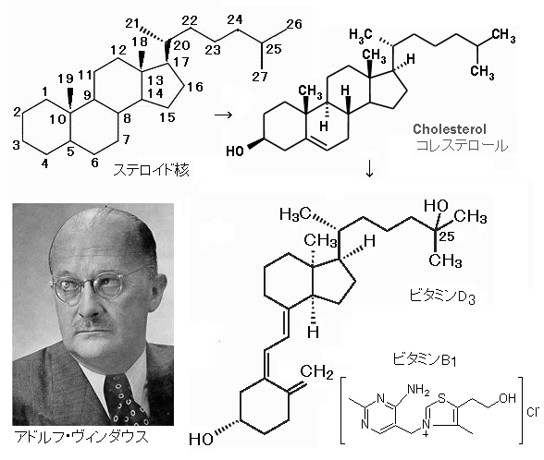
The 1928 Nobel Prize in Chemistry was awarded to Adolf Windaus, who discovered the steroid 7-dehydrocholesterol, the precursor of vitamin D.

Slide 15
Vitamin D deficiency (VDD) affects almost 50% of the population.
estimated 1 billion people worldwide, across all ethnicities and age groups.
High prevalence of VDD is a particularly important public health issue because of its independent risk factor for total morbidity and mortality in the general population.

Slide 16
Vitamin D: The Sunshine Hormone
Fat soluble vitamin (stored in fat)
Hormone precursor
acts more like a hormone than a vitamin
Related to steroid hormones
“neurosteroid”, endogenous, synthesized from cholesterol, regulator of a number of genes

Slide 17
Forms of Vitamin D
Vitamin D consists of 2 bioequivalent forms.
Form | Other Name | Source
Vitamin D2 (D2) | Ergocalciferol | dietary vegetable sources oral supplements
Vitamin D3 (D3) | Cholecalciferol | skin exposure to UVB radiation in sunlight food sources such as oily fish and variably fortified foods oral supplements

Slide 18
D3 ≠ D2 ≠ 1α,25-di(OH)-D3
D3 is made in the skin* (or ingested in supplements) – not biologically active
Cholecalciferol
D2 is from plants** (not humans) – only 1/3 as active as D3
Ergocalciferol
1α,25-di(OH)-D3 is converted in the kidney and other tissues - biologically active
“Vitamin D”
Calcitriol
25-OH-D is the storage form, NOT biol. active
*From 7-dehydrocholesterol **From ergosterol

Slide 19
Sources

Slide 20
Sources
Vitamin D is unique, in terms of its metabolism and physiologic features and the human reliance on both endogenous production (activation through exposure to ultraviolet B light) and exogenous sources (diet, primarily fortified foods) to meet biological requirements.

Slide 21
Sources of vitamin D

Slide 22
% | Source
About 70-90% | is made in the skin by the action of ultraviolet light from the sun
10-30% | from diet.

Slide 23
Aside from rich sources such as oily fish, the vitamin D content of most foods is between 50 and 200 IU per serving.
This value varies greatly by region of the world because fortification markedly improves the availability of vitamin D through diet.

Slide 24
Relation of sunlight & Vitamin D

Slide 26
Facts about Vitamin D

Slide 27
Vitamin D Basics
Units: ng/mL vs. nmol/L
2.5 nmol/L = 1 ng/mL
If data are in nmol/L, divide by 2.5 for ng/mL
Rule of thumb
For every 100 IU vitamin D3 ingested, blood level of 25-OH-D increases by 1 ng/mL
1 μg of D3 or D2 = 40 IU

Slide 28
Global
1 billion cases of Deficiency or Insufficiency worldwide

Slide 29
Prevalence of Vitamin D Deficiency
In several studies, 40 to 100% of U.S. and European elderly men and women are vitamin D deficient
More than 50% of postmenopausal women taking rx for osteoporosis are vitamin D deficient
45/80 (56.2%) of geriatric patients in a UCDSOM study of vit. D education intervention study were vitamin D deficient.
(Holick et al. J Clin Endocrinol Metab 2005)
(VandeGriend et al. J Am Pharm Assoc 2008)

Slide 30
Regional
Northern China where 42% of infants were found to suffer from this disease during the winter/spring period.
North China (Beijing) hypovitaminosis:
89% of Chinese adolescent girls
48% of old men had severe deficiency
Among postmenopausal women serum 25(OH)D level lower amongst the Malays (44±11nmol/L) than the Chinese (69±16nmol/L)
In SEA ,80% of the apparently healthy population is deficient in vitamin D (<20 ng/mL) and up to 40% of the population is severely deficient (<9 ng/mL).
Holick MF. Vitamin D Deficiency. N Engl J Med 2007; 357: 266--281.
Arya V, Bhambri R, Godbole MM, Mithal A.Vitamin D tatus and its relationship with bone mineral density in
healthy Asian Indians. Osteoporsis Int 2004; 15(1): 56-- 61.

Slide 31
Regional
Prevalence of hypovitaminosis D (25(OH)D <75nmol/L) in postmenopausal women
47% in Thailand,
49% in Malaysia,
90% in Japan
92% in South Korea
The mean serum 25(OH)D concentration was 48nmol/L in premenopausal women from Indonesia (6°S) and Malaysia (2°N)

Slide 32
South East Asia, Middle East and North Africa

Slide 33
Pakistan
Pakistan:
The median level of serum vitamin D was 18.8 (IQ range 12.65–24.62) ng/dL. A total of 253 (84.3%) respondents had low levels (30ng/dL) of 25OH vitamin D.
In Karachi, 55% of infants and 45% of mothers had very low serum 25(OH)D levels (<25 nmol/L or 10 ng/mL).
Adil Sheikh1, Zeb Saeed1, Syed Ali Danial Jafri2, Iffat Yazdani2, Syed Ather Hussain2*Vitamin D Levels in Asymptomatic Adults-A Population Survey in Karachi, Pakistan. PLoS ONE | www.plosone.org 1 March 2012 | Volume 7 | Issue 3 | e33452

Slide 34
India
In North India (27ºN): Hypovitaminosis D in
96% of neonates , 91% of healthy school girls , 78% of healthy hospital staff and 84% of pregnant women .
In South India (13ºN): hypovitaminosis D
Inverse relationship between measured serum 25(OH)D levels and PTH levels
Vitamin D levels were significantly higher in rural compared to urban subjects
Lucknow,India found that 84%t of pregnant women had 25(OH)D values below 22 ng/mL
Sachan A, Gupta R, Das V, et al. (2005) High prevalence of vitamin D deficiency among pregnant women and their newborns in northern India. Am J Clin Nutr 81:1060-1064.
8. Puri S, Marwaha RK, Agarwal N, et al. (2008) Vitamin D status of apparently healthy schoolgirls from two different socioeconomic strata in Delhi: relation to nutrition and lifestyle. Br J Nutr 99:876-882.

Slide 35
Srilankna
In Sri Lanka (7ºN), mean 25(OH)D among healthy females was 35.3nmol/L
40.5% of them had 25(OH)D values below 25nmol/L .
High prevalences
Skin pigmentation
traditional clothing.
Air pollution
limited outdoor activity
urban population
Rodrigo MD (2007) Peak bone mass measured by phalangeal BMD and its association with nutritional status, socioeconomics status and physical activity: a community based cross sectional study in Galle district, Sri Lanka. In. Extract from PHD thesis (unpublished).

Slide 36
Bangladesh
Vitamin D deficiency (serum 25-OHD level <25 nmol/l) was detected in 39% of young women (university students), 30% in veiled women and 38% in diabetic women, respectively.
Vitamin D insufficiency defined as serum 25-OHD concentration <40 nmol/l was detected in 78% of group A, 83% in group B and 76% in group C, respectively.
Md Zahirul Islam PhD1, Mohammed Akhtaruzzaman PhD2 and Christel Lamberg-Allardt PhD, Hypovitaminosis D is common in both veiled and nonveiled Bangladeshi women. Asia Pac J Clin Nutr 2006;15 (1): 81-87

Slide 37
Bangladesh
Vitamin D deficiency (serum 25-OHD level <25 nmol/l) was detected in 39% of young women (university students), 30% in veiled women and 38% in diabetic women, respectively.
Vitamin D insufficiency defined as serum 25-OHD concentration <40 nmol/l was detected in 78% of group A, 83% in group B and 76% in group C, respectively.
Md Zahirul Islam PhD1, Mohammed Akhtaruzzaman PhD2 and Christel Lamberg-Allardt PhD, Hypovitaminosis D is common in both veiled and nonveiled Bangladeshi women. Asia Pac J Clin Nutr 2006;15 (1): 81-87

Slide 38
Knowledge in bangladesh (rural and Urban)
Though the rural students are less familiar with vitamin D (p<0.001) and osteoporosis (p=0.0056) than urban students, they exercise a healthy diet in terms of milk consumption (p<0.0001) and engage themselves more in outdoor activities
Spend more time in sunlight (p<0.0001) than the urban students.
Thus the rural students may require less supplemental support of calcium and/or vitamin D than the urban students (p<0.0001).
Dewan Taslima Akhter1†, Riaz Uddin2†*, Dilshad Yasmin2 and Rajia Sultana Nijhu2
Calcium and Vitamin D Related Knowledge in 16-18 Years Old Adolescents: Does Living in Urban or Rural Areas Matter J Nutr Food Sci Volume 3 • Issue 6 • 1000240

Slide 39
Men (Husband) versus Pregnant Women in Bangladesh
50% of the men but only 23% of women spent ≥2 hours outdoors per day during daytime hours (n = 82, p=0.0007).
24% of men and 0% of women reported outdoor professions (p<0.0001).
Men’s mean 25(OH)D (55.2 ±17.5 nmol/L) was significantly higher than women’s (21.6 ±10.7nmol/L)
(mean difference = 30.7 nmol/L; p<0.0001).
A significantly lower proportion of men (6.0%) were vitamin D deficient (25(OH)D<30nmol/L) vs women (21.7%; p<0.0001)
Joy Shi2, Eszter Papp2, Abdullah Al Mahmud3, Alison Gernand4 and aniel Roth1,2 Lindsay Ruiter1,2, JHPN,Vol 10:11-16Vitamin D Status of Husbands of Pregnant Women in Dhaka, Bangladesh

Slide 40
Low (l) versus high(H) socioeconomic in Bangladesh
Seventeen percent of women in group L and 12% of women in group H had serum 25-OHD concentration <25 nmol/l.
Hypovitaminosis D (serum 25-OHD concentration 37.5 nmol/l) was observed in 50% of subjects in group L and 38% of subjects in group H, respectively.
The prevalence of hypovitaminosis was higher in lactating subjects of the groups L and H (63 and 46%, respectively)
MZ Islam1, C Lamberg-Allardt1*, M Ka¨rkka¨inen1, T Outila1, Q Salamatullah2 and AA Shamim2Vitamin D deficiency: a concern in premenopausal Bangladeshi women of two socio-economic groups in rural and urban region. European Journal of Clinical Nutrition (2002) 56, 51–56

Slide 41
DMCH study (Preeclampsia and Eclampsia)
The prevalence of vitamin D insufficiency was very high with more than 3 quarters (78 %) of all subjects having a serum 25(OH)D level < 30 ng/ml.
The mean serum 25(OH)D level was 24.86 ng/ml in controls, 23.96 ng/ml in preeclamptic women, and 21.56 ng/ml in eclampsia patients.
The odds of developing preeclampsia and eclampsia may increase by up to 5-fold in women with vitamin D insufficiency
M. I. Ullah 1 , C. A. Koch 1 , 2 , S. Tamanna 2 , S. Rouf 3 , L. Shamsuddin 4,Vitamin D Defi ciency and the Risk of Preeclampsia and Eclampsia in Bangladesh.Hormone and Metabolic Research · June 2013

Slide 42
PMCH Study
Sex | a. Male (n=56) b. Female (n=156) | 14.29 12.64 | 4.68 4.74
10- 20.9 ng/ml | Deficient | 147 | 68.9 percent
Location | a. Rural (n=54) b. Urban (n=158) | 15.20 12.33 | 4.50 4.58
Socio-economic status | a. Lower (n=18) b. Middle(n=180) c. Higher(n=14) | 15.0 12.74 14.0 | 3.67 4.92 4.35

Slide 43
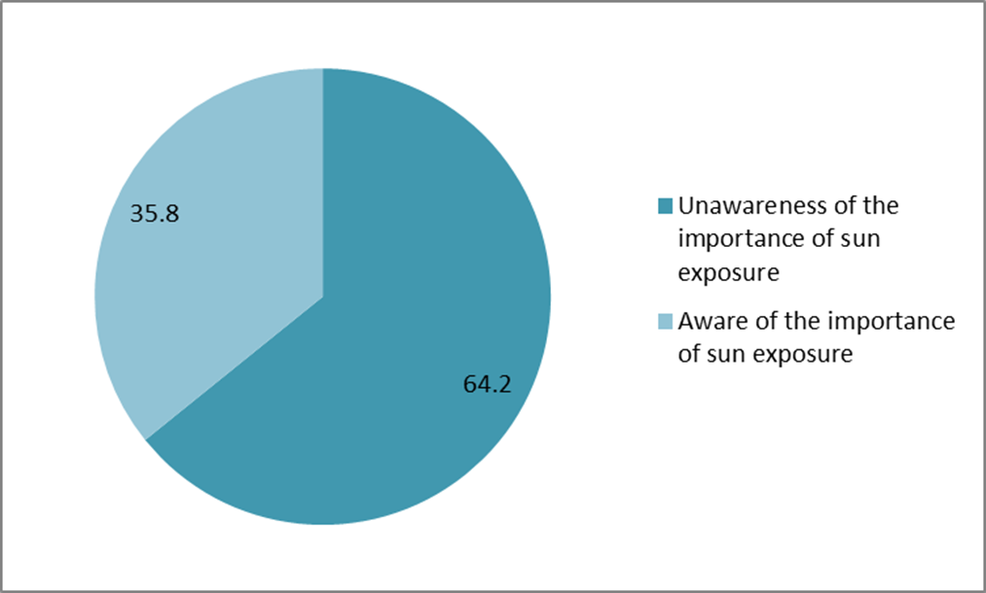
Awareness of the importance of sun exposure
One of the most striking finding from our study is the unawareness of the importance of sun exposure among 2/3 of our study population (64.2%).
Tahsin H, Islam QT, Khandaker MAK, Ahasan HAMN. Study of Serum Vitamin D level in different socio-demographic population- A Pilot study, ; J medicine 2018;19 : 22-29

Slide 44
Factors influencing photosynthesis and bioavailability of vitamin D

Slide 45
Environmental factors

Slide 46
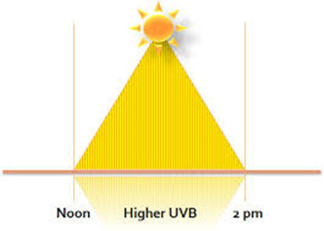
Duration and time of sun exposure-skin produces more vitamin D if exposed it during the middle of the day.
For 20- 30 minutes

Slide 47
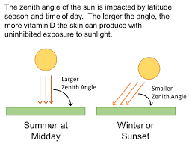
2. Season

Slide 48
3. Latitude
Moving away from the equator, the intensity of UV light decreases, so that at a latitude above 50° (including northern Europe), vitamin D is not synthesized in winter.

Slide 49
The closer to the equator one lives, the easier it is to produce vitamin D from sunlight all year round.

Slide 50
4. Atmospheric pollution- Causes insufficient cutaneous absorption of UVB ( Climate Change)

Slide 51
Patient related factors

Slide 52
1. Clothing style ( using veils)

Slide 53
2.use of sun blocks

Slide 54
The color of skin
Whiter skin make vitamin D more quickly than darker skin.
Darker skins with more melanin allow less UVB to enter the skin.

Slide 55
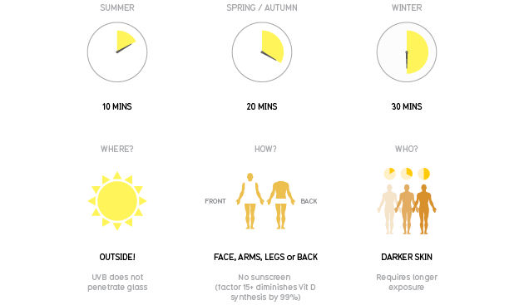
4. The amount of skin exposed
the more skin one exposes, the more vitamin D body will produce.

Slide 56
5. obesity
vitamin D accumulate in adipose tissue with decreased bioavailability and lower serum levels in persons with higher BMI .
Inversely proportional

Slide 57
Aging
Even if regularly exposed to sunlight, elderly people produce 75% less cutaneous D3 than young adults .
Production of 1,25(OH)₂D is reduced by 50% as a result of an age-related decline in renal function
7. presence of several chronic diseases
( like CKD)

Slide 58
Functions and Associations

Slide 60
Metabolic functions of vitamin D
● mobilization of bone mineral. synthesis and secretion of insulin, parathyroid, and thyroid hormones;
● inhibition of production of interleukin by activated T-lymphocytes and production of immunoglobulin by activated B-lymphocytes; differentiation of monocyte precursor cells;
● modulation of cell differentiation, proliferation and apoptosis.

Slide 61
Other Physiologic Functions of Vitamin D
Modulates immune system/pro-inflammatory cytokines= reduction of inflammation
Deficiency: arthritis, lupus, IBS, Multiple sclerosis
Inhibits Cell growth/angiogenesis/differentiation
Deficiency: cancer (prostrate, breast, colon)
Glucose metabolism/pancreatic B-cell function/ insulin sensitivity
Deficiency: diabetes mellitus

Slide 62
Physiologic Functions of Vitamin D
Influences smooth muscle tone, endothelium, cardiomyocytes, controls intracellular Ca+, RAAS
Deficiency: cardiovascular disease, hypertension, stroke
Anti-oxidative/neuroprotective
Deficiency: dementia, Alzheimer's, schizophrenia, depression
Neuromuscular stability
Deficiency: myofascial pain, musculoskeletal pain, myopathy

Slide 63
Features of Vitamin D Deficiency

Slide 64
Features of Vitamin D deficiency..contd..
Clinical manifestations of
Vitamin D deficiency
Musculoskeletal disorders:
- non specific muscle pain,
- poor muscle strength
- Proximal muscle weakness
- low BMD (osteoporosis)
- ↑ risk of fall & fracture
Non-musculoskeletal disorders:
-↑ risk of RTI,
- diabetes mellitus
-possibly cardiovascular diseases, hypertension
- Schizophrenia & depression
- Cancer ( eg- colon, breast, ovarian & prostate )

Slide 65
Musculoskeletal Manifestations

Slide 67
The most well-known consequences to not having enough vitamin D are rickets in children and osteomalacia in adults.
The consequences are numerous and include skeletal diseases, metabolic disorders, cancer, cardiovascular disease, autoimmune diseases, infections, cognitive disorders, and/or mortality.

Slide 68
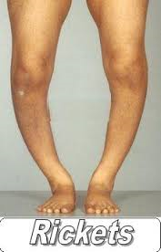
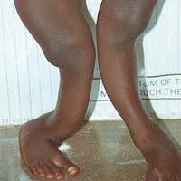
Features of Vitamin D deficiency

Slide 69
There are vitamin D receptors in human muscle that have a direct effect on muscle strength. A severe vitamin D deficiency can cause myopathy, which can cause muscle weakness and pain.

Slide 70
Non Skeletal Menifestations

Slide 71
Cancer- There is an association between an increased risk of various internal malignancies (for example, colon, breast, ovarian, melanoma, and prostate cancer)
More research needs to be done to determine if there is a definite link between supplementing with vitamin D and the prevention of cancer.

Slide 72
Cardiovascular disease: Vitamin D deficiency is associated with an increased prevalence of hypertension, hyperlipidemia, peripheral vascular disease, coronary artery disease, myocardial infarction, heart failure, and stroke.
Research is being done to determine exactly how this works and why.
Islam QT, Amin MR . VITAMIN D DEFICIENCY- CURRENT STATUS AND ITS IMPACT IN CLINICAL MEDICINE, ( Editorial) Bangladesh J Medicine 2017; 28: 1-3

Slide 73
Infections: Observational studies have shown an association between low vitamin D status and an increased risk of both upper and lower respiratory tract infections.
The role of vitamin D in reducing the risk of hospital-acquired infections, such as pneumonia, bacteremias, urinary tract infections, and surgical site infections is also being investigated.

Slide 74
Depression: The association between lack of sunlight and depressive disorders was first noted 2,000 years ago.
Vitamin D deficiency has been associated with an 8%-14% increase in depression.
Reducing the risk of type 2 diabetes: Research has shown that those with blood vitamin D levels over 25 ng/mL had a 43% reduced risk of developing type 2 diabetes compared with those with levels under 14 ng/mL.

Slide 75
Tuberculosis: Individuals with tuberculosis (TB) have been shown to have lower vitamin D levels than healthy people. Supplementation has shown to improve symptoms in these individuals.

Slide 76
Vitamin D an RA
Vitamin D deficiency has been linked with several autoimmune disorders, including rheumatoid arthritis (RA). The relationship between the severity of RA and serum levels of Vitamin D is a subject of immense interest and therapeutic implications.

Slide 77
Mean serum Vitamin D levels in rheumatoid arthritis patients and controls
Assessment of Vitamin D in Rheumatoid Arthritis and Its Correlation with Disease Activity. Narendra Meena, Sumit Pal Singh Chawla, Ravinder Garg, Anil Batta, and Sarabjot Kaur. J Nat Sci Biol Med. 2018 Jan-Jun; 9(1): 54–58

Slide 78
New clues about vitamin D functions in the nervous system
Accumulating data have provided evidence that 1α,25 dihydroxyvitamin D₃ [1,25-(OH)₂D₃] is involved in brain function.
Neuroprotective and immunomodulatory effects of this hormone have been described in several experimental models, indicating the potential value of 1,25-(OH)₂D₃ pharmacological analogs in neurodegenerative and neuroimmune diseases.

Slide 79
Multiple sclerosis:
Evidence continues to accumulate supporting the role of vitamin D and the prevention and treatment of multiple sclerosis (MS).

Slide 80
Epilepsy
Vitamin D has been considered as neurosteroid, and its pivotal role in neuroprotection, brain development, and immunomodulation has been noticed in studies.
The potential role of vitamin D in the pathophysiology and treatment of epilepsy, as one the most prevalent neurological disorders, has received attention in recent years

Slide 81
Transverse Myelitis
The potential role of vitamin D supplementation in neuroinflammatory diseases has been of great interest in recent years. Small prospective studies in patients with multiple sclerosis suggest that it may impact relapse rates and/or disease progression.
(Goldberg, P, Fleming, MC, Picard, EH. Multiple sclerosis: decreased relapse rate through dietary supplementation with calcium, magnesium and vitamin D. Med Hypotheses 1986; 21: 193-200.)

Slide 82
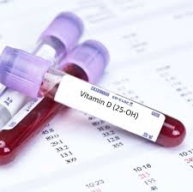
How to evaluate vitamin D status?

Slide 83
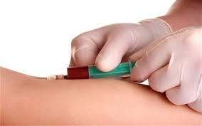
The serum 25(OH)D is the most reliable marker of vitamin D status.
reflecting the sum of cutaneous synthesis and oral intake.

Slide 84
What is an optimal 25(OH)D level?
25(OH) D level ( ng/ml) | Interpretation
>=30-80 | Normal
21- 29 | Insufficient
10-20 | Deficient
< 10 | Severely deficient
Notes:
Ref-Sadat-Ali M, AlElq A, Al-Turki H, Al-Mulhim F, Al-Ali A. Vitamin D levels in healthy men in eastern Saudi Arabia. Ann Saudi Med 2009; 29:378-82.

Slide 85
Who should be tested for Vitamin D deficiency???

Slide 86
Measurement of serum 25(OH)D levels is expensive
and universal screening is not supported.
However, vitamin D testing may benefit those at risk for severe deficiency

Slide 87
Clinical Risk Factors for Vitamin D Deﬁciency
I. Decreased intake
Inadequate oral intake
Malnutrition (poor oral intake)

Slide 88
Clinical Risk Factors for Vitamin D Deﬁciency
II.Limited sun exposure
Home bound/ institutionalized
Dark skin
Living in High latitude
Winter season
Sunscreen users
Wearing skin covering clothes

Slide 89
Clinical Risk Factors for Vitamin D Deﬁciency
III. Gastrointestinal
Malabsorption
IV. Hepatic
Some antiepileptic medications (increased 24-hydroxylase activity)
Severe liver disease or failure (decreased 25-hydroxylase activity)

Slide 90
Clinical Risk Factors for Vitamin D Deﬁciency
V. Renal
Aging (decreased 1-α hydroxylase activity)
Renal insufficiency, GFR <60% (decreased 1-α hydroxylase activity)
Nephrotic syndrome (decreased levels of vitamin D–binding protein)

Slide 91
Clinical Risk Factors for Vitamin D Deﬁciency
VI. Elderly patients (> 50 years)
VII. Obesity (BMI> 30 kg/m2)-body fat sequesters the vitamin

Slide 92
Clinical Risk Factors for Vitamin D Deﬁciency
It has been suggested that clinicians should routinely test for hypovitaminosis D in patients with musculoskeletal symptoms, such as bone pain, myalgias, and generalized weakness, because these symptoms are often associated with hypovitaminosis D .

Slide 93
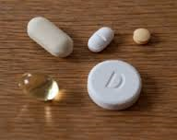
Management

Slide 94
Management
Many patients and physicians think that adequate vitamin D intake can be obtained via diet alone.
This assumption is erroneous

Slide 95
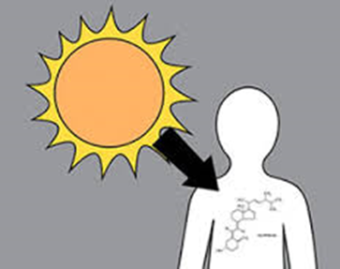
Management..contd..
As there are only small amounts of vitamin D in food there are only 2 sure ways to get enough vitamin D:
1. Taking vitamin D supplements.
2. Exposing bare skin to sunlight to
get ultraviolet B (UVB).

Slide 96
Vitamin D supplements

Slide 97
Vitamin D supplements
Available forms of vitamin D supplements are
Ergocalciferol (vitamin D2)
Cholecalciferol (vitamin D3).
Vitamin D3 is preferred , as
It is the naturally occurring form of the vitamin
Vitamin D3 >3 times as effective as D2
Longer duration of action

Slide 98
Vitamin D supplements
Dosing — The recommended dose of vitamin D depends upon the nature and severity of the vitamin D deficiency.

Slide 99
Vitamin D supplements
The lower the 25(OH)D serum concentration is before treatment, the higher is the dosage that is needed in order to quickly reach an acceptable serum level.

Slide 100
Vitamin D supplements
Treatment involves an initial high-dosage treatment phase, which can be given on a daily or weekly basis until the required serum levels are reached,
followed by the maintenance of the acquired levels.

Slide 101
Vitamin D supplements
Therapy prescriptions vary, and there is no consensus yet on how best to arrive at an optimum serum level.

Slide 102
Vitamin D supplements :Dosage
According to Endocrine Society Practice Guideline:
Age | Initial Therapy | Duration | Maintenance
Upto 1 year | 2000 IU/ day or | 6 weeks | 400-1000 IU/day
 | 50,000 IU/ week
1- 18 years | 2000 IU/ day or | 6 weeks | 600-1000 IU/day
 | 50,000 IU/ week
> 18 years | 6000 IU/ day or | 8 weeks | 1500- 2000 IU/day
 | 50,000 IU/ week

Slide 103
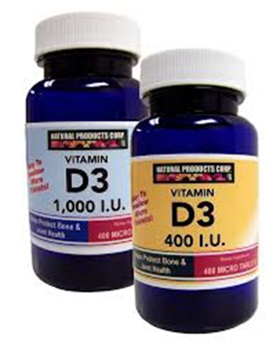
Vitamin D supplements
In obese patients ,
patients with malabsorption syndromes &
patients on medications affecting vitamin D metabolism
2- 3 times higher doses are required.

Slide 104
Vitamin D supplements
If the 25(OH)D concentration remains persistently low despite several attempts at correction with oral vitamin D,
a trial of ultraviolet B light therapy (ie, by tanning lamps) may be considered to improve vitamin D status.

Slide 105
Vitamin D supplements
For every 100 IU vitamin D3 ingested, blood level of 25-OH-D increases by 1 ng/mL
10 IU vitamin D is the biological equivalent of 0.25 μg cholecalciferol/ergocalciferol.

Slide 106
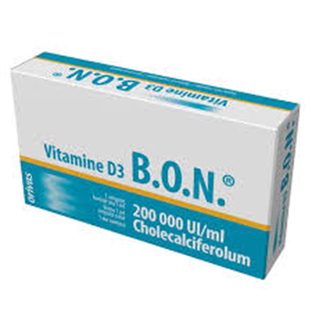

Slide 107
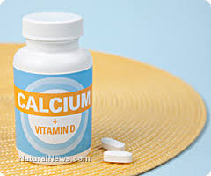
Management..contd..
Need for other vitamins or minerals? —
During treatment for vitamin D deficiency, it is important to consume calcium.
Calcium can be found in food sources or dietary supplements
Group | Dose
Men & premenopausal women | 1000 mg/ day
postmenopausal women | 1200 mg/ day

Slide 108
Management..contd..
Monitoring —
A blood test is recommended to monitor blood levels of 25(OH)D 3 months after beginning treatment.
The dose of vitamin D may need to be adjusted based on these results.

Slide 109
Management..contd..
Side effects —
Side effects of vitamin D are uncommon unless the 25(OH)D level becomes
very elevated (>100 ng/mL) and
the person is taking high dose calcium supplements.

Slide 110
Management..contd..
Exposing bare skin to sunlight (ultraviolet B)

Slide 111
Full-body sun exposure producing slight pinkness in light-skinned persons results in vitamin D production equivalent to ingesting 10,000-25,000 IU

Slide 112
Exposing skin to UVB and the risk of skin cancer
Research to date shows that moderate but frequent sun exposure is healthy but
over exposure and intense exposure can increase risk of skin cancer.

Slide 113
Prevention

Slide 114
Unprotected sun exposure is the major source of vitamin D for both children and adults.

Slide 115
10- 15 minutes exposure of hands, arms and face without sunscreen 2-3 times / week may be sufficient especially between the hours of 10 am and 3 pm ( depending on skin sensitivity)

Slide 116
Sensible sun exposure, produces vitamin D in the skin that may last twice as long in the blood compared with ingested vitamin D

Slide 117
Prevention..contd..
Recommended dietary intake of vitamin D for patients at risk of vitamin D deficiency is as follows :
Age group | Vitamin D supplement
In infants and children up to 1 year old | at least 400 IU/day, to maximize bone health
In children and adolescents 1-18 years of age | at least 600 IU/day to maximize bone health
In adults 19-70 years of age | at least 600 IU/day to maximize bone health and muscle function
> 70 year of age | 800 IU/day

Slide 118
Prevention..contd..
The Canadian Paediatric Society recommends that pregnant or breastfeeding women consider taking 2000 IU/day, that all babies who are exclusively breastfed receive a supplement of 400 IU/day.

Slide 119
Contraindiations of vit D supplement
Hypersensitivity to vitamin D,
Primary hyperparathyroidism.
“Vitamin D hypersensitivity syndromes”
Chronic granulomatous diseases, such as sarcoidosis, and lymphoma can become hypercalcemic.

Slide 120
Effects of intermittent high-dose of vitamin D regimens
Rather than very high doses of intermittent vitamin D replacements, more frequent lower-doses regimens should be opted. Clearly, further research is needed to better understand these findings.

Slide 121
Controversy over Calcium and Vitamin D: Calcium or No Calcium

Slide 122
There had been some controversy as regards the additional benefit of adding calcium to vitamin D.
Due to these concerns, it is to recommend that supplementing calcium in addition to vitamin D is only for those who are at increased risk of osteoporosis.

Slide 123
Vitamin D toxicity
Although excess vitamin D supplementation can lead to hypercalcemia, vitamin D toxicity is extremely rare
generally occurs only after ingestion of large doses of vitamin D (>10,000 IU/d) for prolonged periods in patients with normal gut absorption or in patients who may be concurrently ingesting generous if not excessive amounts of calcium.

Slide 125
Vitamin D toxicity cont..
Excessive intakes of vitamin D can lead to hypercalcemia.
The symptoms of this are
weakness,
confusion,
constipation,
loss of appetite, and
development of painful calcium deposits.

Slide 126
Vitamin D Toxicity cont..
Published reports of vitamin D toxicity have nearly all involved intake ≥ 40,000-50,000 IU per day for prolonged period of times.
Heavy sun exposure with excessive supplementation of vitamin D
causes toxicity.

Slide 127
The majority of our knowledge about vitamin D has been discovered over the past 15 years, and with the growing issue of deficiencies, more health connections with vitamin D levels are being made.
Correcting vitamin D deficiency is not as simple as taking a pill or getting more sun.

Slide 128
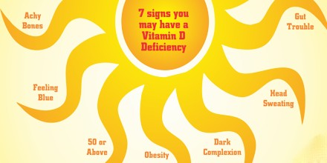
Take Home Messages
Vitamin D deficiency is common worldwide
25 OH vitamin D is a predictor of bone health in terms of fracture risk and risk of falls
25 OH vitamin D is also an independent predictor of risk of
Cardiovascular disease,
hypertension,
cancer,
diabetes,
all cause mortality, and
URTI

Slide 129
Take Home Messages..contd..
Sensible sun exposure is a great way to maintain vitamin D sufficiency

Slide 130
Take Home Messages..contd..
Physicians should screen for vitamin D deficiency who are at risk based on diet, sun exposure, obesity indices, age, sex & lifestyle factors, as features of hypovitaminosis D are mostly reversible with proper replacement.

Slide 131
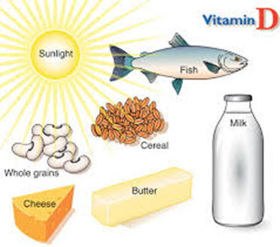
Take Home Messages..contd..
Public health efforts in Bangladesh should try to
Increase awareness about the importance of sun exposure and
encourage the consumption of natural food sources rich in vitamin D.

